Slide 1
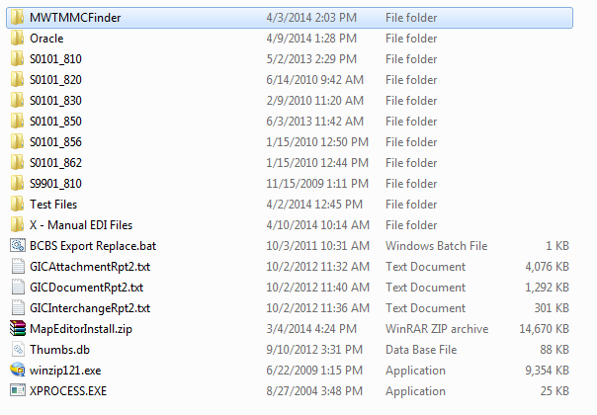
MWTMMCFinder
Part 1: Structure and Scripts

Slide 2

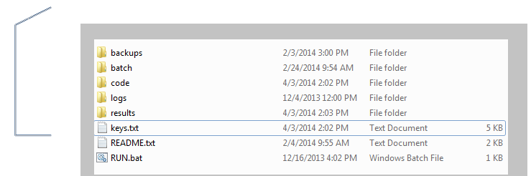
This is the root folder
.bat files
Old code, ignorable
Java code
Errors and console output.
Starts the program
Copy-paste invoice numbers to this file
Basic instructions
Output ISO file is created in here

Slide 3


clean.bat
This batch file deletes the temporary files created by the JAVA program.

Slide 4


810 merge batch
Merge backups
856 merge batch
Neither of these two batch files are actually run by the program. Instead, they exist to easily switch between looking in 856 and 810. Merge.bat is the file that is actually run, and you overwrite Merge.bat with either one of these, depending on where you want the program to pull the records from. You may want to replace “\IN_EDI_BK” with “\IN_ARCHIVE” to search the archive instead.

Slide 5
This batch file is commanded to run by the JAVA program. The goal of this batch file is to compile all of the stored ISO files into a big one for easy searching. It does this in order of most recent file to oldest file. This will created a merged.txt, that is the file the JAVA program reads. As long as this batch creates a merged.txt of invoice records, the JAVA program can search it properly. This allows for easy swapping of the path to all the ISO files we want to search.
Merge.bat

Slide 6
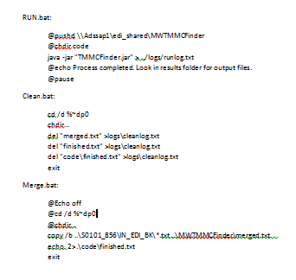
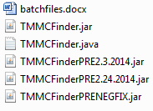
This is just a text backup of the batch files in the batch folder.
Batcfiles.docx

Slide 7
This is the JAVA program which will run. After making changes to the code, you must compile the .java code into a .jar to run the program. Overwrite this JAR file with the new JAR file. RUN.bat runs this exact file by its name, so it’s important that it keeps this exact name.
TMMCFinder.jar

Slide 8
This is the java code in readable and editable form. This file is not actually run by the program, and is here for you to change the code of the program and then compile it into a runnable JAR file. In the next PPT, I will give a more detailed breakdown of the code in part 2.
TMMCFinder.java

Slide 9
These are all older versions that I made a backup of after a significant change. These should be ignorable, and are mostly for comparing with the latest JAR build.
Other JAR files

Slide 10

This file should be empty. If there are any errors during the clean.bat process, the errors will be printed to this file. There really shouldn’t be any error other than if it has an issue with properly finding a file or directory.
Cleanlog.txt

Slide 11
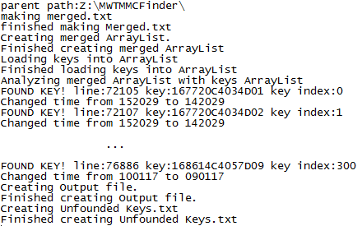
This file is created by the JAR program. It contains all of the console output of the process.
Runlog.txt
It confirms each key it finds. The most recent change to the code changed the way in which the time is decremented, so it currently prints out the time changing for easy debugging.

Slide 12
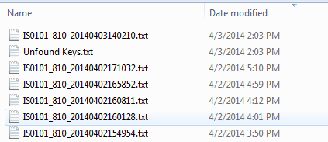
You will want to view this folder as sorted by date modified.

Slide 13
This contains a proper ISO file, ready to reload into the system.
Latest ISO file

Slide 14

This is the total number of keys in the
Keys.txt file which were not found in
the merged.txt file
Unfound Keys.txt
The total number of keys that were successfully matched in the merged.txt file

Slide 15
These are the previously created ISO files. These are the reason we want to sort this folder by date modified – it would be hard to find the ISO file you just created otherwise.
Older ISO files

Slide 16


The RUN batch
This will properly start the JAR program

Slide 17
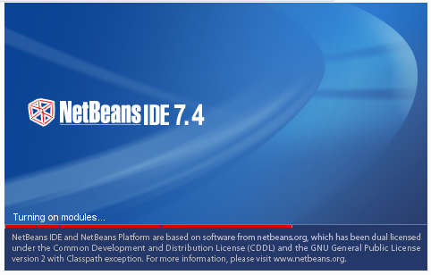

MWTMMCFinder
Part 2A: Getting started with JAVA

Slide 18

Editing Java
Java can be edited in notepad, or pretty much any text editor, however, I strongly recommend you use an IDE instead.
Netbeans is the IDE I use, it is free and works very well for this purpose. Eclipse is also free and is another popular choice.
When you edit the code, it doesn’t save to update the current MWTMMCFinder. You must create a runnable file from the JAVA code file. This runnable file is a JAR file. IDEs can create a JAR file based off of the JAVA code. In Netbeans, after you “build” the code, it creates a JAR file in a specific directory which you will want to copy and paste into the proper folder inside the MWTMMCFinder folder.
The code for this program should not need any structural changes. The only changes I could see that need to be done is small number changes, like how much you change the time on a record by, or updating the paths in the code if the folders get moved around.

Slide 19
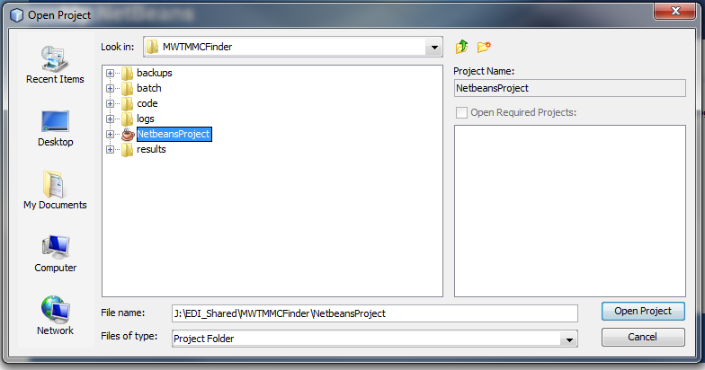
Opening the code in Netbeans
In Netbeans, click File>Open Project. Once this window pops up, browse to the root folder, and click on and open up NetbeansProject.

Slide 20
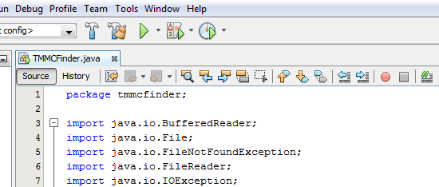
Building the Jar
This button will compile the code into a JAR file. Do this after you are finished editing the code.

Slide 21
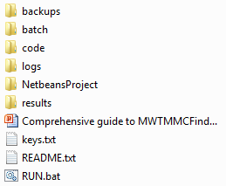


Finding the JAR
Rename this to TMMCFinder.jar and overwrite the TMMCFinder.jar that is inside of root/code/ with this new build.

Slide 22
Part 2B
Understanding the TMMCFinder JAVA code

Slide 23

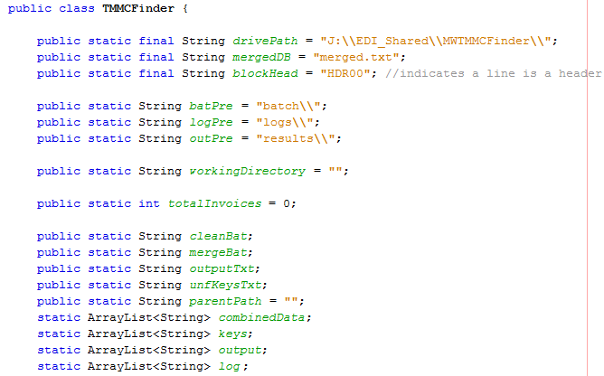
TMMCFinder.java
Don’t mess with the package declaration, or the imports.
These are global variables. That means that they are accessible anywhere in this program.

Slide 24



Globals
drivePath is the variable that stores the path to the root folder. If you change the location of the MWTMMCFinder, you will need to update this path to be correct. Notice the “\\”, that is the same thing as a “\”, it is just how you need to type them in JAVA.
These variables store the subpath (assuming you are already in root) to the batch, logs, and results folders. You shouldn’t need to change these unless you move those individual folders relative to the root folder.
This is used to count the number of invoices that it is being requested to find.
These are used to dynamically create important paths based on the path variables mentioned above.
An ArrayList is a fancy storage bin with conveniently built in methods for manipulation. Here I am declaring 4 of these storage bins to store Strings for our merged file(combinedData), our keys file(keys.txt), our output file(the ISO), and our log file(runlog.txt).

Slide 25
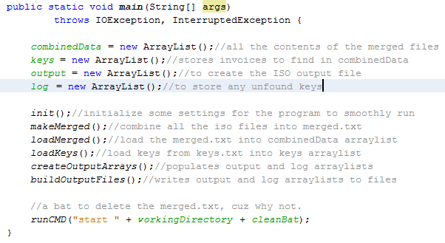
Main method
Initializes the arrays. This makes them fresh, empty ArrayLists.
This section tells the program to run the other methods, in that order. Each method has a commented summary of what it does next to the “method call”. Other than createOutputArrays(), these are simple methods that load the files into the arrays, or writes the arrays to the files
This tells the program to run the clean.bat

Slide 26


createOutputArrays method
We are going to perform the bulk of this method for each key in the keys.txt
Making sure we don’t do the same key twice in a row
This method will look for that key in the merged.txt storage Array, and it will add the fetched invoice data to the output array. If it finds the key, it sets the found boolean to true, if it doesn’t find the key, it sets it to false.
If we didn’t find the key, make note of it in the log. Now, at the end of the loop, we go back and search for the next key in the keys.txt storage array.

Slide 27
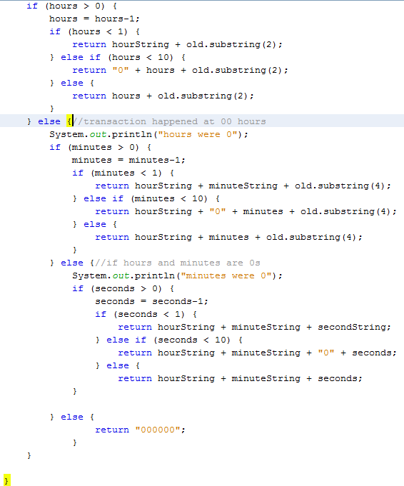
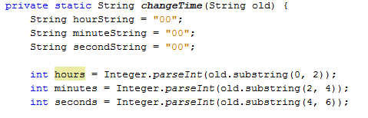
changeTime()
The last important thing that might need changed would be the logic behind the time changing method.
This is called when adding to the output array for the ISO file.
This handles all cases that do not happen during the midnight hour, it just decrements by 1 hour
When this method is used, it is given a 6 digit string that is the time for the particular invoice. That string is stored in the variable “old”. This block of code breaks this string apart and stores its values as numbers into hours, minutes, and seconds.
If it is during the midnight hour, and the minutes aren’t at 0, this decrements by 1 minute
If minutes and hours are 00, we look at seconds. If they are 00, we return a literal value. If not, decrement the seconds.
If the invoice time is exactly midnight, it will keep it at midnight. You might want to put something else here so that it does still change the time, in this rare case.

Slide 28
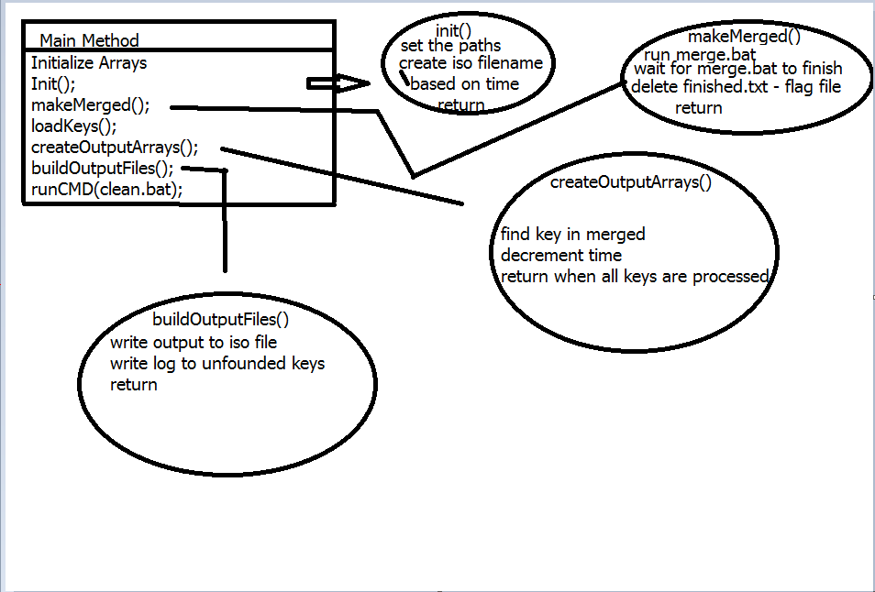
Program flow

Slide 29
Some last notes:
I recommend making a backup of the root folder immediately, and putting it somewhere safe. I will also have a copy of this folder in my possession at home, so if you do lose it completely, you can get a copy at http://github.com/sniktawekim/MWTMMCFinder If you have any other questions, feel free to ask by emailing me at sniktawekim@gmail.com
-Michael Watkins

